Slide 1
Using a Modified Bréguet Range Equation to Assess the Feasibility of Hybrid Aircraft Designs
James Atkinson

Slide 2
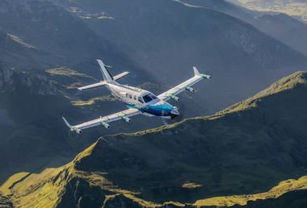
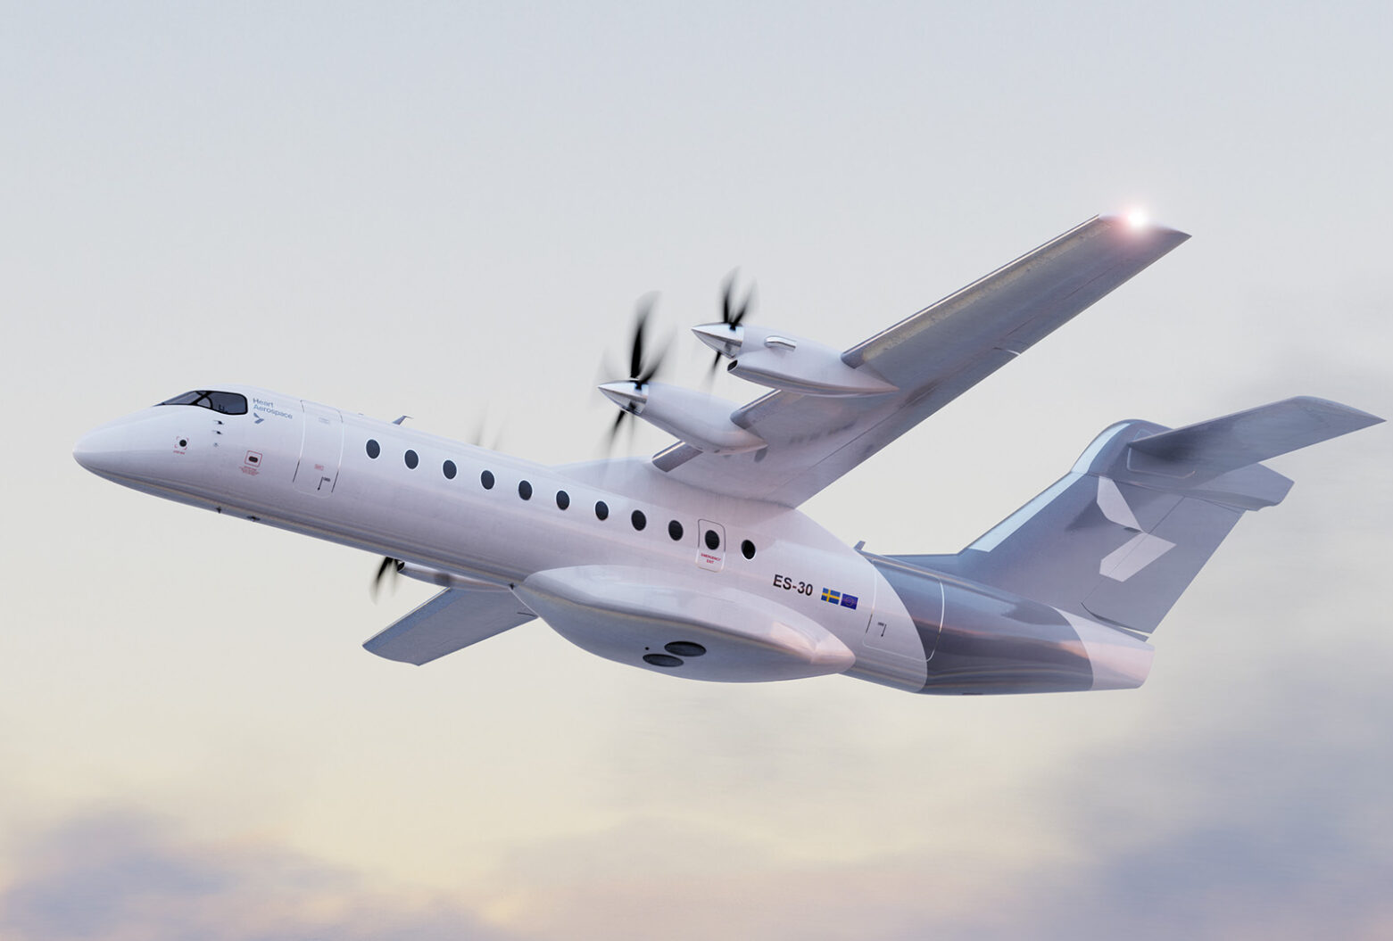
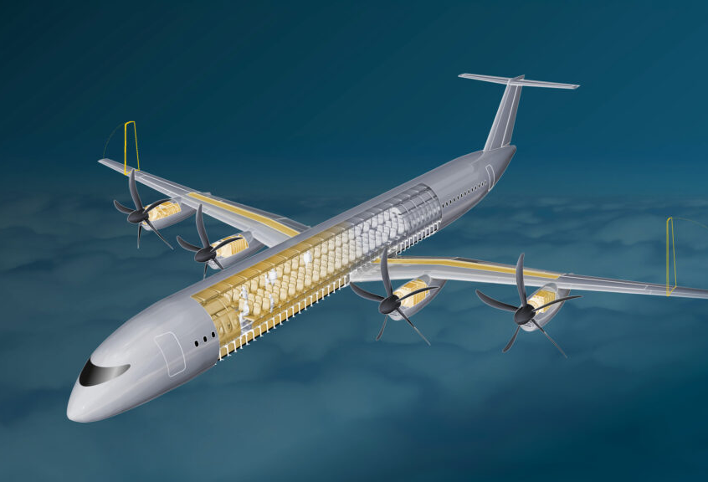
What good is this research?
Hybrid aircraft designs gathering interest from industry and academia
Feasibility contingent on multiple factors
Need to determine when and where hybridisation is an appropriate strategy
Notes:
Hybrid aircraft designs gathering interest from industry and academia
Climate impact reduction
Reduced fuel burn
Reduced fuel cost
Feasibility contingent on multiple factors:
Battery energy density
Specific strength of airframes
Improvements in aerodynamic design
To make a case for where hybrids could replace conventional aircraft:
Need to determine how much fuel we can save
Need to consider a wide number of airframes
Need to figure out how changing mass of aircraft and battery energy density influences fuel saving for a given range

Slide 3
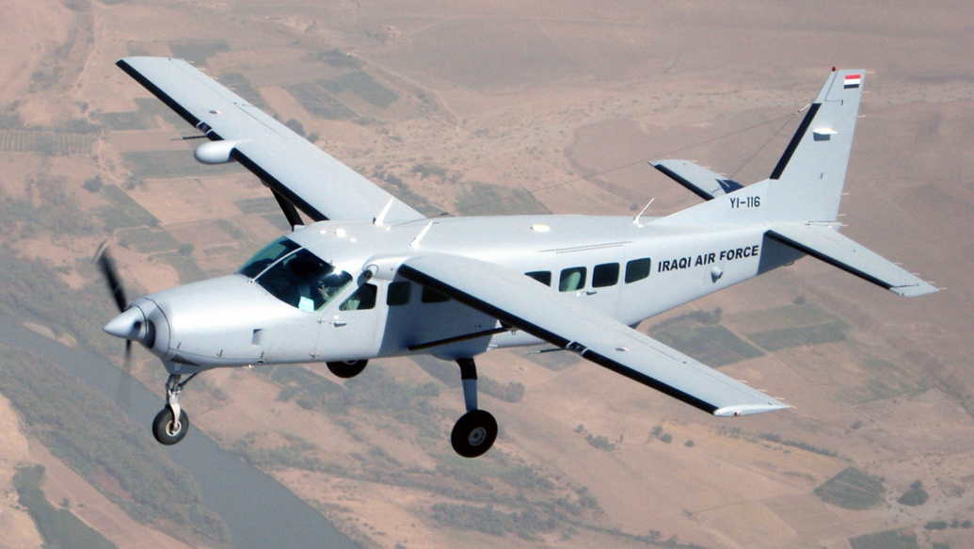
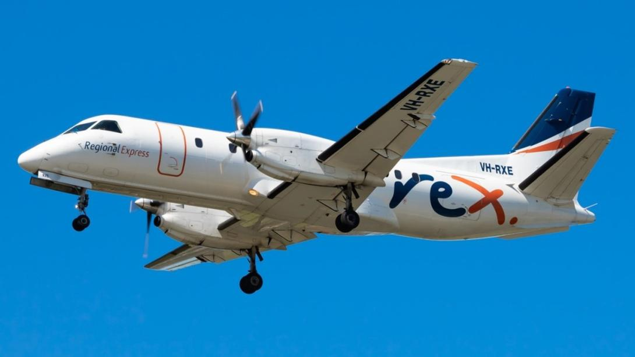
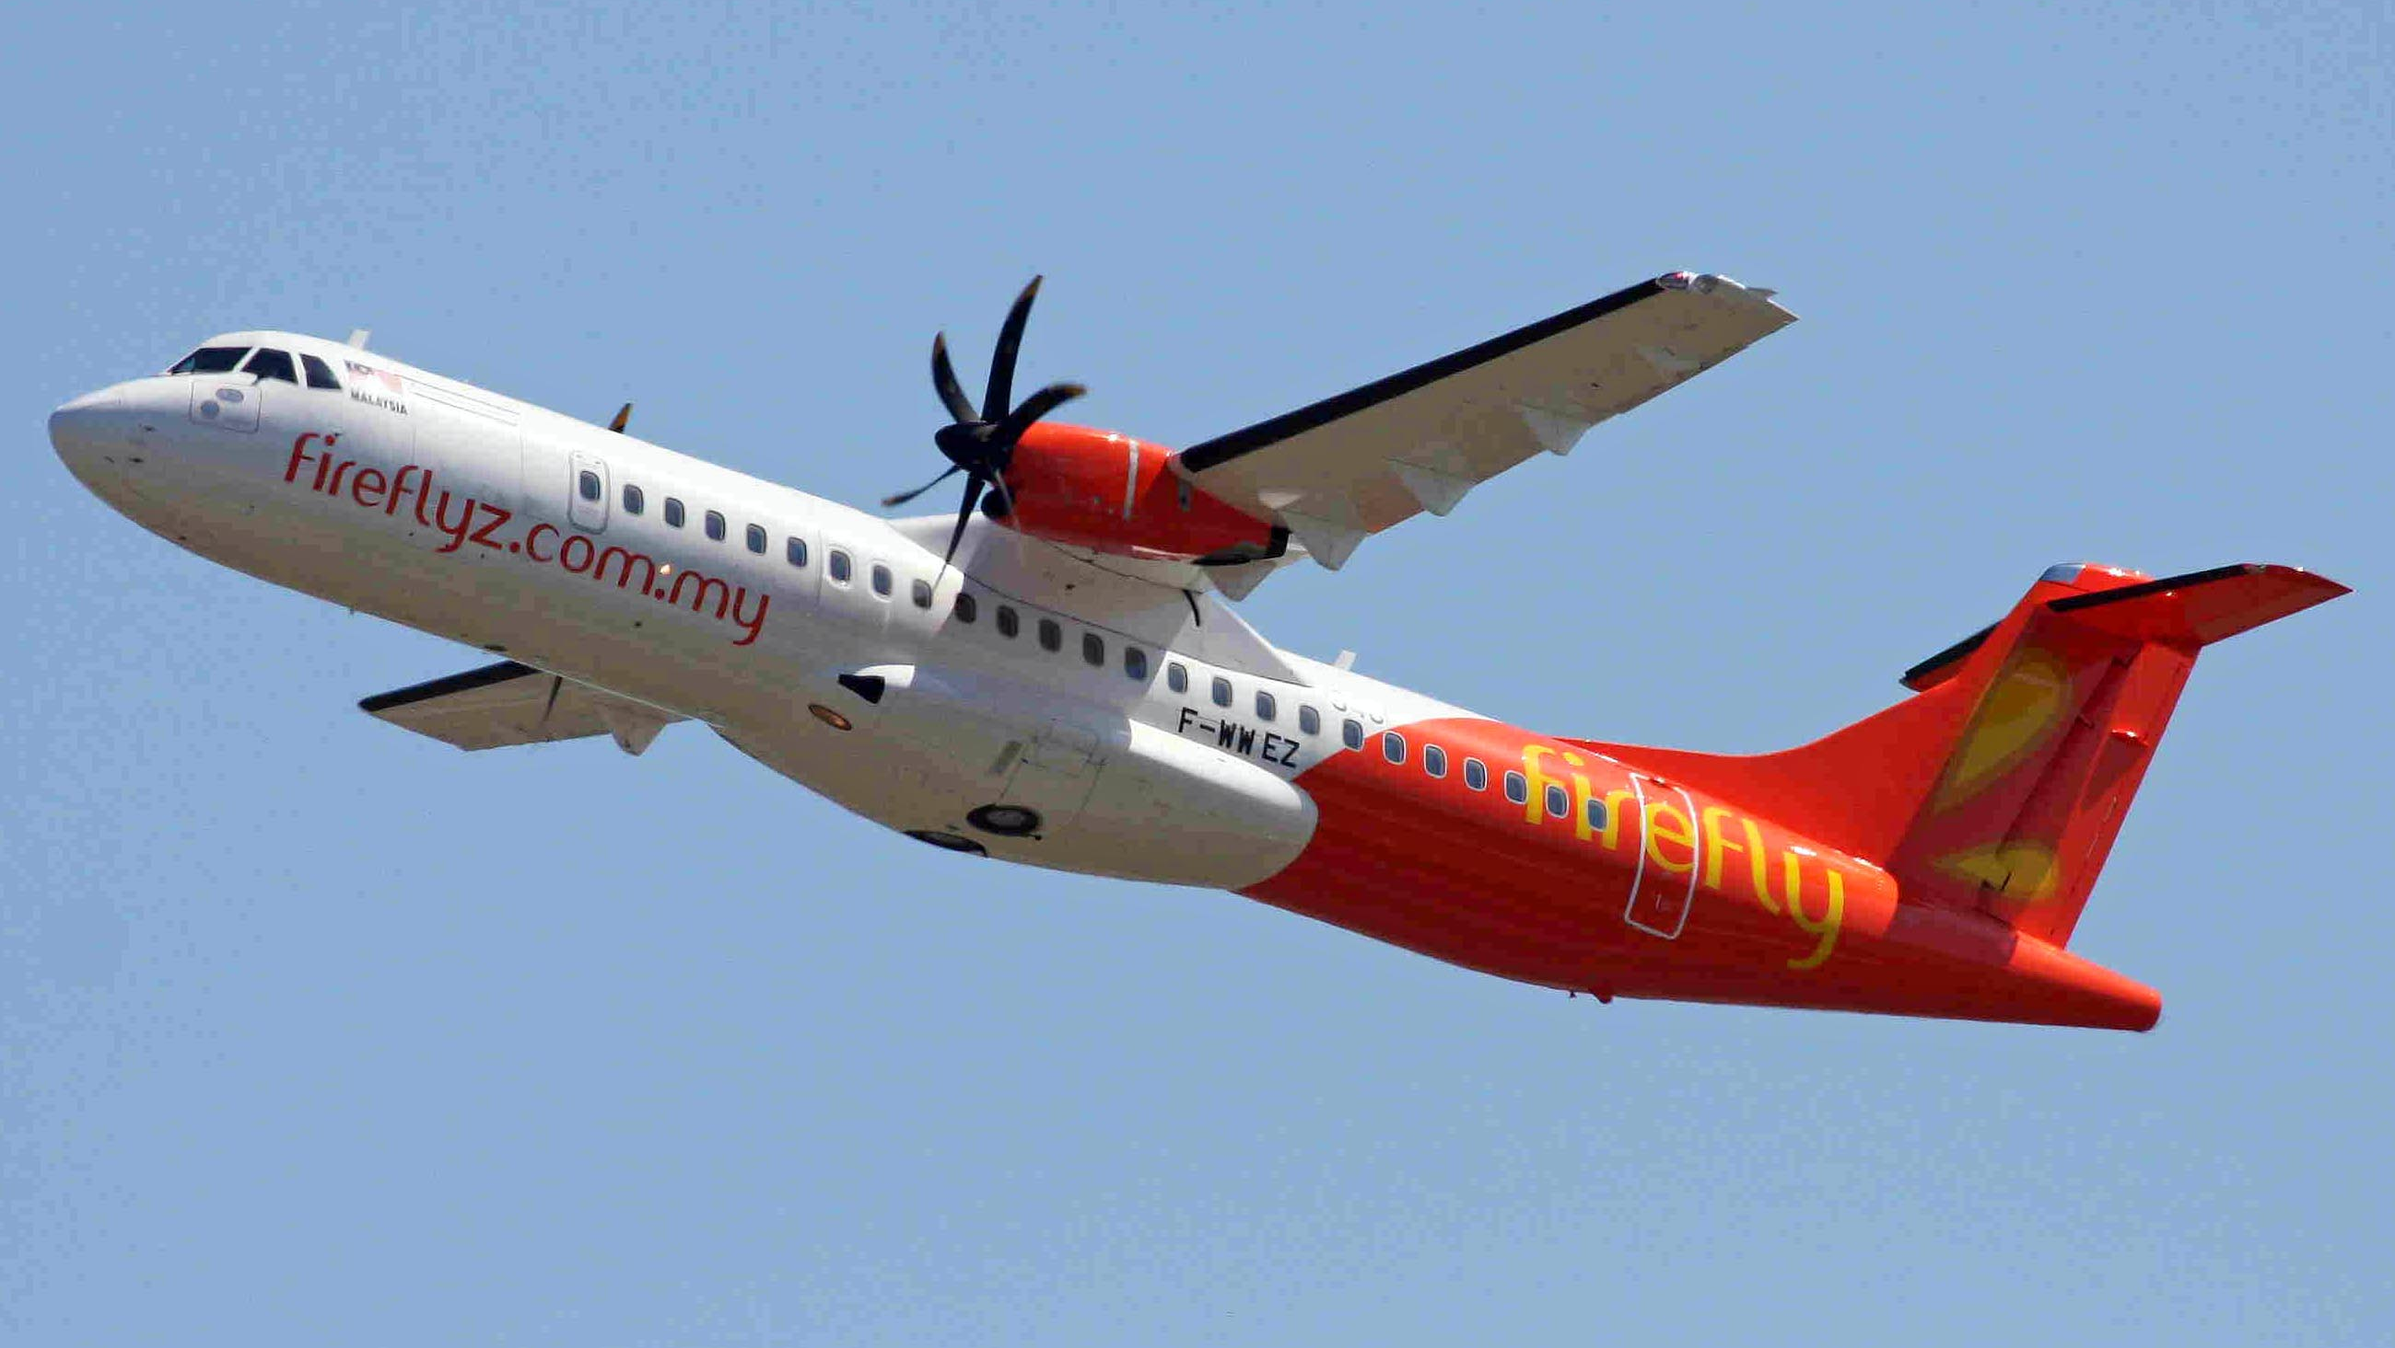
Conventional Aircraft Used as Benchmarks
 | OEW (kg) | MTOW (kg) | Payload (kg) | PSFC (kg/J) *10^-8 | Cl/Cd
Cessna Caravan 208 | 2145 | 3629 | 1200 | 11.1348 | 13.5
Saab 340B | 8620 | 13155 | 3298 | 7.7893 | 14
ATR 72-600 | 13600 | 23000 | 7400 | 7.9076 | 16.8
[1],[2], [3], [4], [5] and [6]
Notes:
Aircraft parameters determined from CFD papers, brochures and Purdue University Website
Some uncertainty in parameters, takeoff PSFC, slightly different propulsors

Slide 4
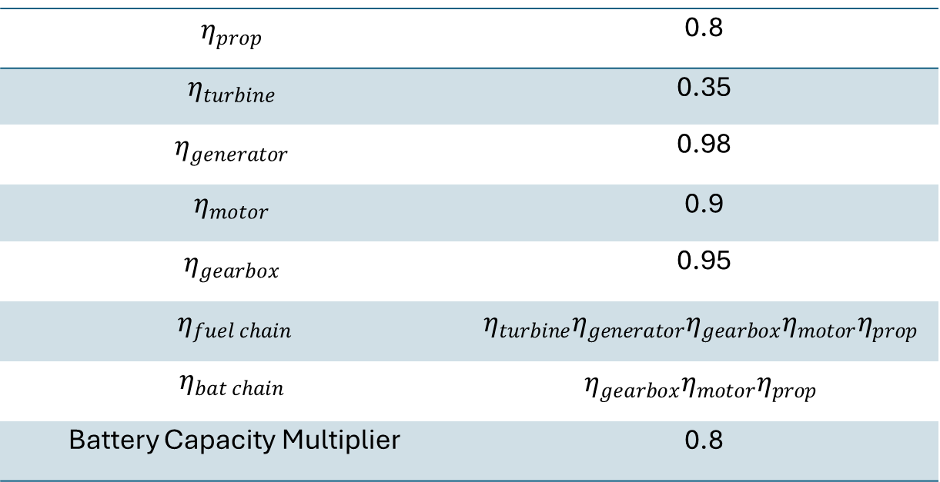
Efficiency Data
$$η_{prop}$$ | 0.8
$$η_{turbine}$$ | 0.35
$$η_{generator}$$ | 0.98
$$η_{motor}$$ | 0.9
$$η_{gearbox}$$ | 0.95
$$η_{fuel chain}$$ | $$η_{turbine}η_{generator}η_{gearbox}η_{motor}η_{prop}$$
$$η_{bat chain}$$ | $$η_{gearbox}η_{motor}η_{prop}$$
Battery Capacity Multiplier | 0.8
Extracted from Batra et al [11] for Series Hybrid Aircraft

Slide 5
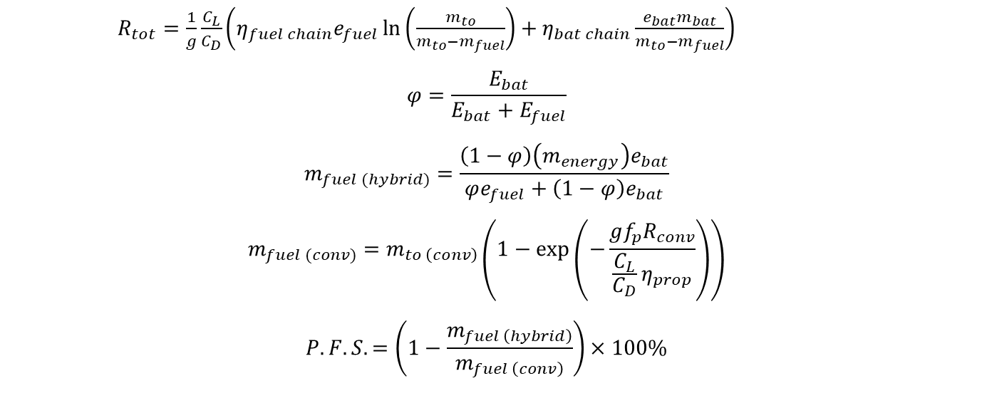
Equations for Analysis
$R_{tot}=\frac{1}{g}\frac{C_{L}}{C_{D}}\left(η_{fuel chain}e_{fuel}\ln\left(\frac{m_{to}}{m_{to}−m_{fuel}}\right)+η_{bat chain}\frac{e_{bat}m_{bat}}{m_{to}−m_{fuel}}\right)$
$$φ=\frac{E_{bat}}{E_{bat}+E_{fuel}}$$
$$m_{fuel (hybrid)}=\frac{\left(1−φ\right)\left(m_{energy}\right)e_{bat}}{φe_{fuel}+\left(1−φ\right)e_{bat}}$$
$$m_{fuel (conv)}=m_{to \left(conv\right)}\left(1−\exp\left(−\frac{gf_{p}R_{conv}}{\frac{C_{L}}{C_{D}}η_{prop}}\right)\right)$$
$$P.F.S.=\left(1−\frac{m_{fuel \left(hybrid\right)}}{m_{fuel \left(conv\right)}}\right)×100\%$$
Notes:
Derived from assuming steady level flight
Assumes fuel is burned at beginning of mission
Assume efficiency parameters do not change throughout the mission

Slide 6
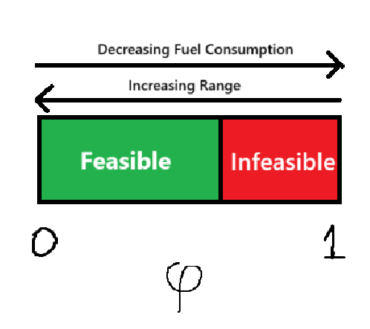
How to save the most fuel?
Increase degree of hybridization?
→Decrease range
Decrease degree of hybridization?
→Increase fuel consumption
Need to find the maximum degree of hybridisation that can permit a given range

Slide 7
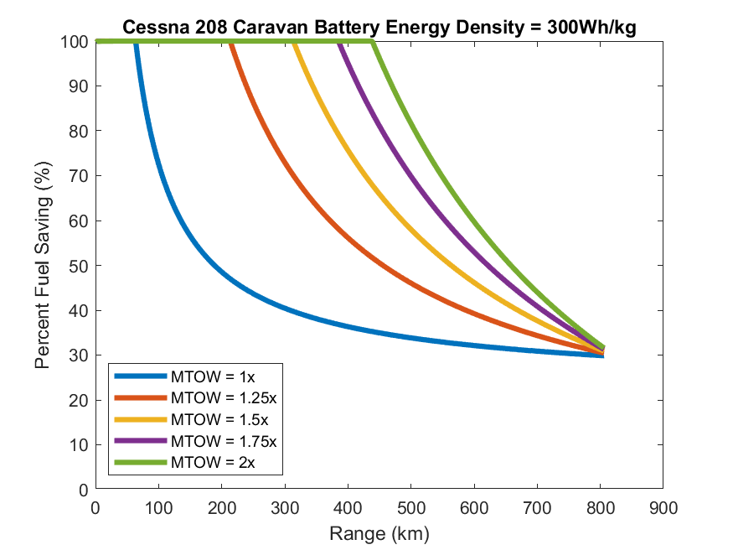
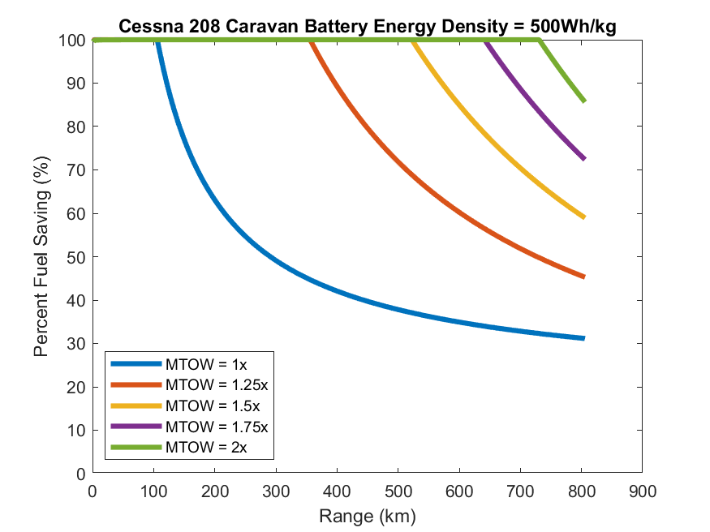
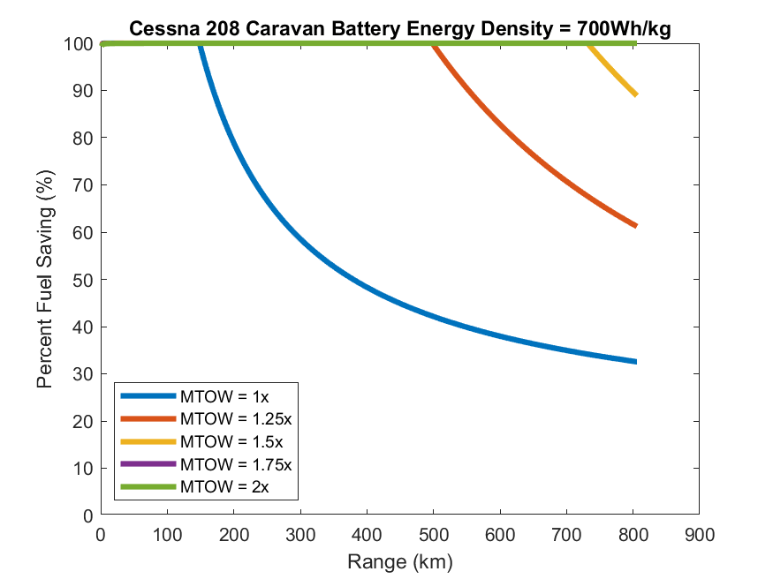
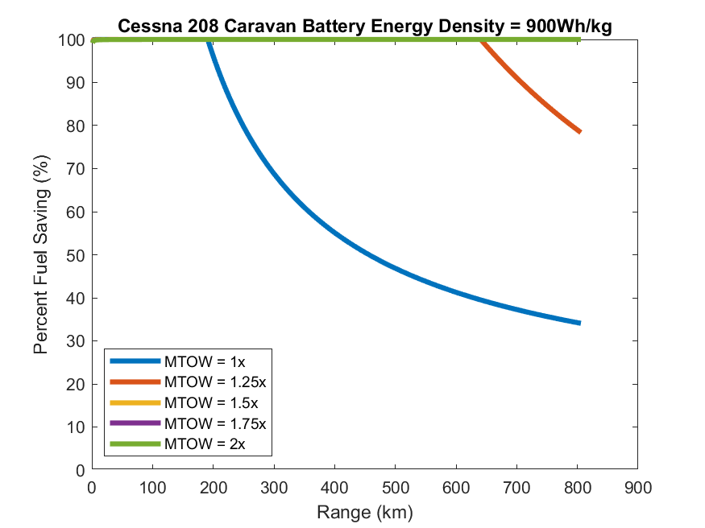
Results (Cessna 208 Caravan)

Slide 8
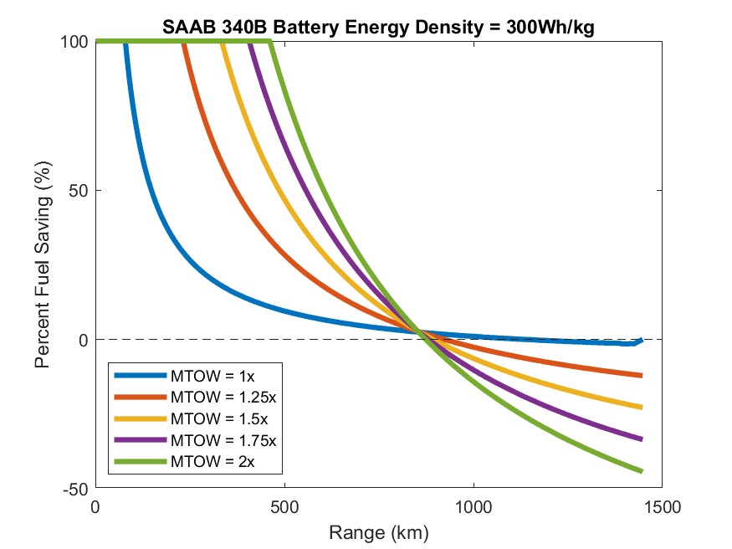
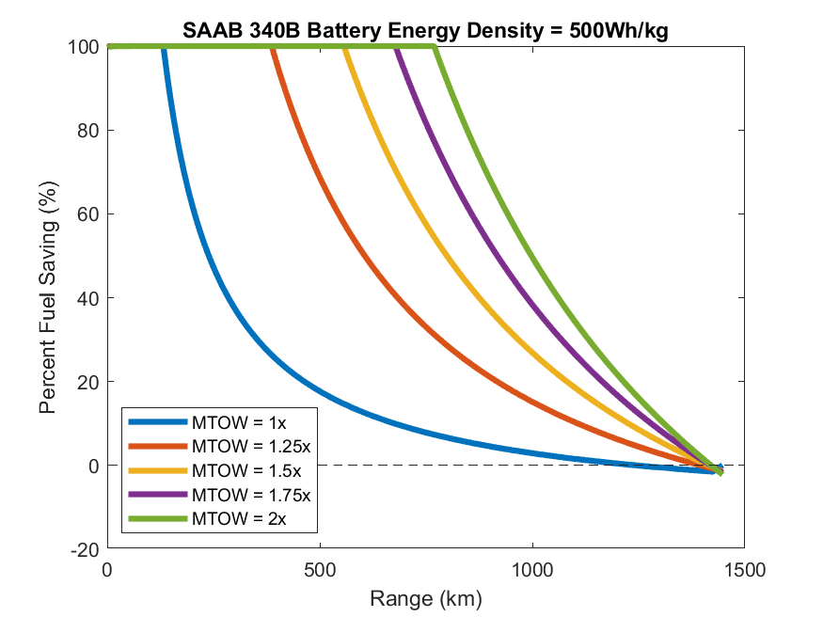
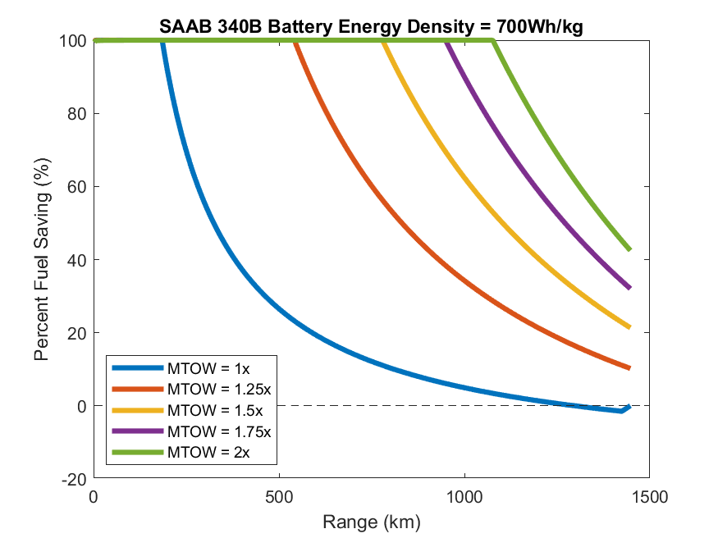
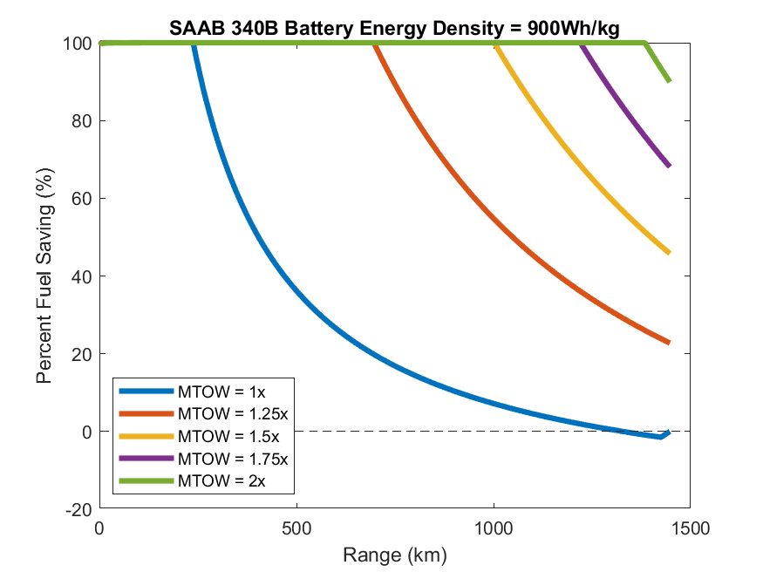
Results (Saab 340B)

Slide 9
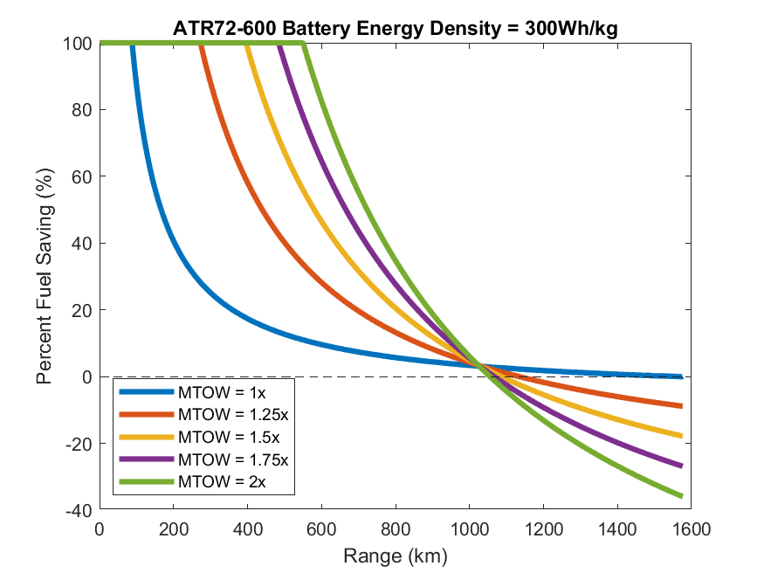
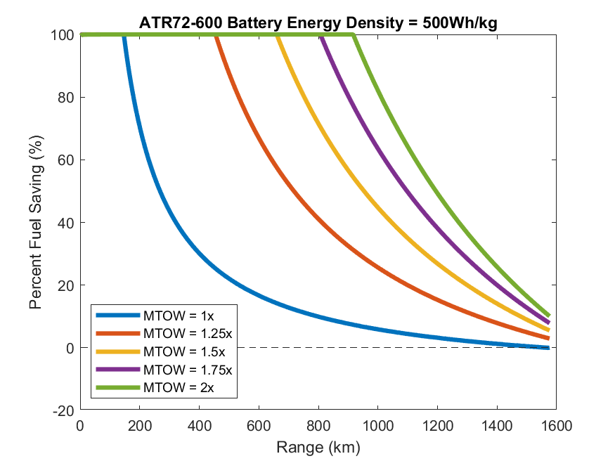
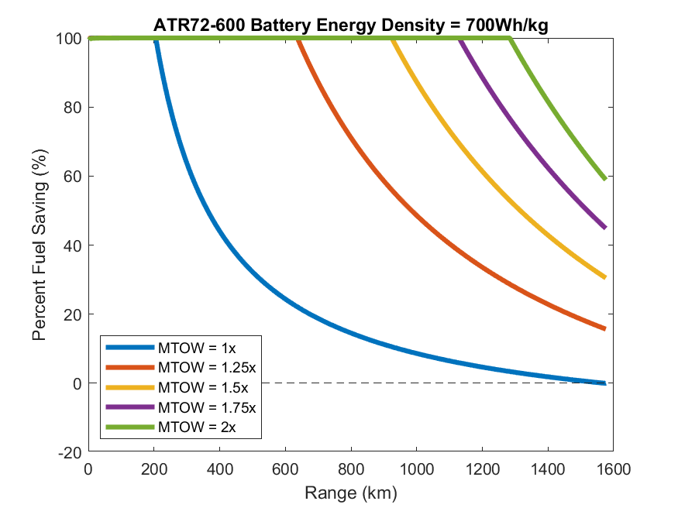
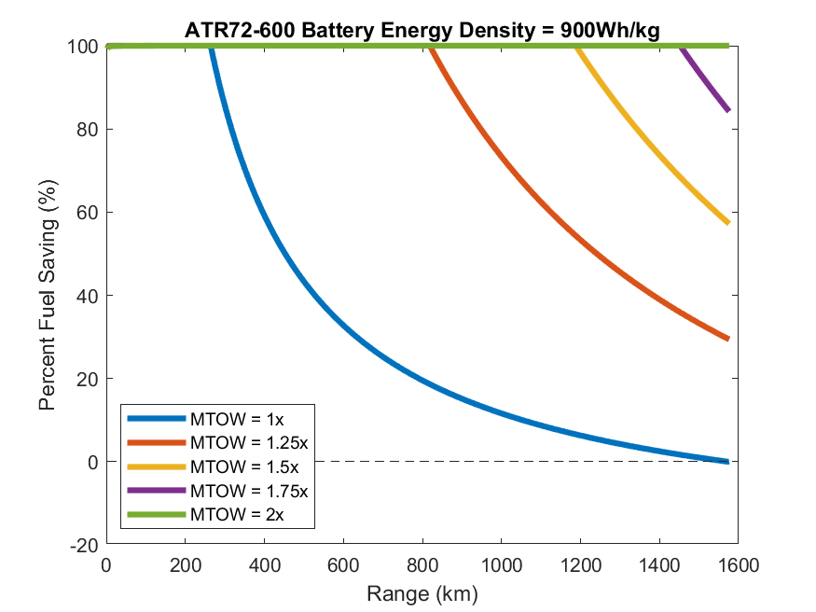
Results (ATR72-600)

Slide 10
Key takeaways
Intersection point lies well below the conventional range for 300 Wh/kg
Even with current battery technology, Cessna Caravan can achieve significant fuel savings below 800 km
Law of diminishing returns between increasing MTOW and saving fuel
For larger aircraft, battery energy densities above 500 Wh/kg required to make a dent in fuel consumption

Slide 11
Limitations of the model
Assumes aircraft begins and ends flight in cruise
Doesn’t factor in diversions
Doesn’t factor in how the OEW might increase as a function of increasing the MTOW
Energy rather than power-based approach
Doesn’t consider the weight of new onboard mechanisms and how the efficiencies of those mechanisms change with energy split
Treats all efficiencies as constant throughout flight
PSFC for conventional aircraft is taken as the value at takeoff which will likely higher than that for cruise

Slide 12
Challenges for adoption in industry
Heavy landings
New maintenance procedures [7]
Accelerated runway degradation [8]
Electrical infrastructure [7]
Cost of electricity vs jet fuel [9] [10]
1.79x more expensive per unit energy
0.613x more expensive per unit useful energy

Slide 13
Next steps
Consider a wider variety of aircraft and perform more rigorous analysis of aircraft parameters
Factor in structural considerations into trade-off
Determine how aircraft could exploit newer materials/aerodynamic surfaces
Quantify operational cost
Determine for what operators would benefit the most from hybrid designs
Benchmark designs against more accurate flight profile that considers diversions and extra fuel
Flight profile optimisation

Slide 14
Thank you! Contact: jatkinson9@sheffield.ac.uk

Slide 15
References
[1] “Purdue AAE Propulsion Website” Purdue University, 2019. https://engineering.purdue.edu/~propulsi/propulsion/index.html
[2] S. Yusuf, Setyo Hariyadi Suranto Putro, and Nyaris Pambudiyatno, “Numerical Simulation of Effect Modification of Single Slotted Flap on Wing Cessna C208B Grand Caravan for Aerodynamic Performance,” ICATEAS 2022, Feb. 2023, doi: https://doi.org/10.2991/978-94-6463-092-3_2.
[3] K. Sahin, Fazil Gomec, Murat Millidere, and J. Whidborne, “Aerodynamic Analysis of Saab 340B Aircraft with Data Fusion Implementation,” AIAA SCITECH 2024 Forum, Jan. 2024, doi: https://doi.org/10.2514/6.2024-2854.
[4] “Caravan Brochure.” Textron Aviation, 2025. https://cessna.txtav.com/-/media/cessna/files/brochures/turboprop/caravan_brochure.pdf
[5] “Saab340B/Bplus. ” Saab Aircraft Leasing, 2009. https://lipicanaer.eu/wp-content/uploads/2020/01/340B_easa.pdf
[6] “ATR 72-600.” ATR Aircraft, 2022. https://www.atr-aircraft.com/wp-content/uploads/2022/06/ATR_Fiche72-600-3.pdf?_gl=1
[7] Nicolò Avogadro and R. Redondi, “Demystifying electric aircraft’s role in aviation decarbonization: Are first-generation electric aircraft cost-effective?,” Transportation Research Part D Transport and Environment, vol. 130, pp. 104191–104191, May 2024, doi: https://doi.org/10.1016/j.trd.2024.104191.
[8] J. M. Low, R. Stuart Haszeldine, and Julien Mouli-Castillo, “The hidden cost of road maintenance due to the increased weight of battery and hydrogen trucks and buses—a perspective,” Clean Technologies and Environmental Policy, vol. 25, no. 3, pp. 757–770, Dec. 2022, doi: https://doi.org/10.1007/s10098-022-02433-8.
[9] International Air Transport Association, “Jet Fuel Price Monitor,” IATA, 2025. https://www.iata.org/en/publications/economics/fuel-monitor/
[10] Trading Economics, “United Kingdom Electricity Price - 2022 Data - 2013-2021 Historical - 2023 Forecast,” tradingeconomics.com, 2022. https://tradingeconomics.com/united-kingdom/electricity-price
[11] A. Batra, R. Raute, and R. Camilleri, “On the Range Equation for Hybrid-Electric Aircraft,” Aerospace, vol. 10, no. 8, p. 687, Aug. 2023, doi: https://doi.org/10.3390/aerospace10080687.

Slide 16
Image credit in order of appearance
Slide 2:
Airbus: https://www.airbus.com/en/newsroom/stories/2025-01-ecopulse-results-suggest-a-bright-future-for-hybrid-electric-aviation
Heart Aerospace: https://heartaerospace.com/es-30/
DLR: https://exact-dlr.de/aircraft-concepts/
Slide 3:
Lt. Col. Scott Voskovitch, Wikimedia Commons: https://commons.wikimedia.org/wiki/File:Iraqi_Air_Force_Cessna_208_Caravan_training_mission.jpg
Australian Transport Safety Bureau: https://www.atsb.gov.au/media/news-items/2025/saab-340-engine-failure-due-incorrectly-seated-coupling-securing-hydro-mechanical-unit-accessory-gearbox
Ken Fielding, Wikimedia Commons: https://commons.wikimedia.org/wiki/File:F-WWEZ_(948)_ATR.72-212A(500)_FlyFireFly_TLS_30AUG11_(6097869500)_(cropped).jpg

